Slide 1

overview of the US and Europe educational systems
Presented by:
HANAE EL M’RABET
NOUHAILA KRIMEL
MOHAMED AMINE FAKHRE-EDDINE

Slide 2
Summary
Introduction
1
2
University vs College
3
Degre Structure
4
Tuition And financing
6
Admissions and selection
7
Teaching and learning style
8
Conclusion

Slide 3

Introduction

Slide 4
University vs College

Slide 5


University vs College
THE US
EUROPE
Used interchangeably
College covers wide range of institutions
Offers both undergraduate and graduate degrees
Standardized nomenclature
College for secondary education or vocational training
College Does not grant degrees
University grants academic degrees

Slide 6
Degree structure

Slide 7

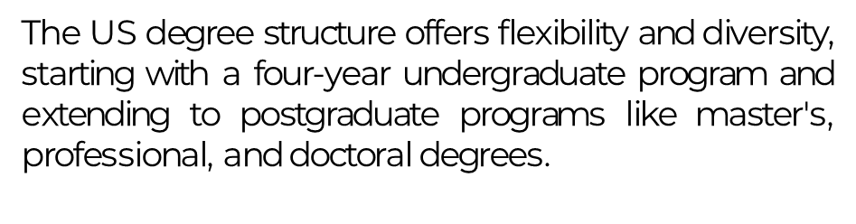

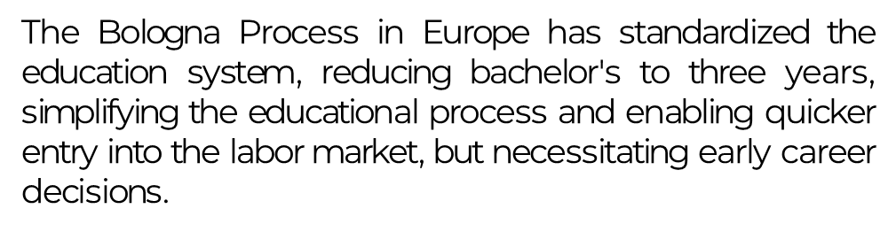

Slide 8
Tuition and selection

Slide 9


Tuition and Financing
In the United States, tuition fees for higher education can be high, and students often rely on loans and scholarships to cover the costs.
By contrast, in Europe, tuition fees are often lower, and some countries offer free education or low-cost options for both domestic and EU students. Student loans are less common.
2
Europe
1
United States

Slide 10

Tuition Costs in the US and Europe
US
The United States is known for its relatively high tuition costs, especially for international and out-of-state students attending public universities.
Many American students accumulate significant debt due to the reliance on loans to finance their education.
Europe
In Europe, particularly in Western and Northern European countries, higher education is characterized by affordable or even tuition-free options for domestic and EU students.
Government subsidies and accessible financial aid contribute to the affordability of education in Europe.

Slide 11

Financial Aid in the US and Eutope
US In the US, students often rely on loans, including federal student loans, to finance their education. Scholarships and financial aid programs are available, but the financial burden often falls on the students. | Europe In Europe, financial aid is more readily available and accessible to students, both domestic and international. Scholarships, grants, and favorable loan terms contribute to the affordability of education.

Slide 12
Admissions and Selection

Slide 13

Admissions and Selection
In the US, admissions are competitive, and a holistic approach is often used, considering grades, standardized test scores, and extracurricular activities.
In Europe, admissions are typically based on academic performance and entrance exams, with less emphasis on extracurriculars.

Slide 14
Teaching and Learning style

Slide 15
Teaching and Learning style
Discuss the teaching and learning methods in higher education. In the US, there's a focus on a broad liberal arts education, with an emphasis on class participation, projects, and a variety of assessment methods. In Europe, the approach is often more specialized and research-oriented, with a strong emphasis on exams.

Slide 16
Conclusion

Slide 17



THANK'S FOR WATCHING
ANY QUESTION ?

